Slide 1
Hydraulic Elevator
By: Gadiel, Ryan, and Noah

Slide 2
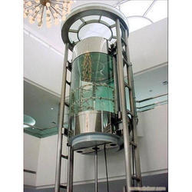
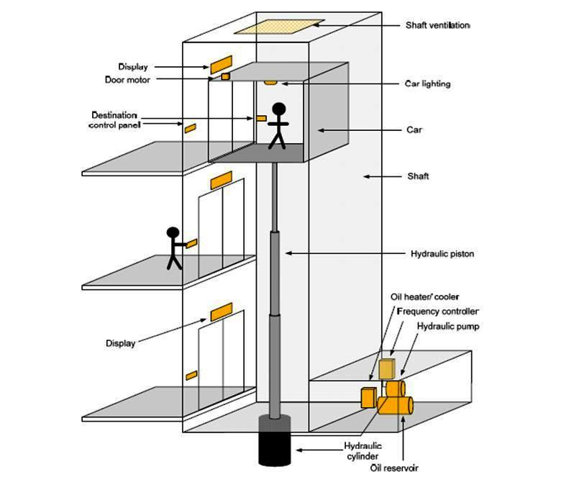

Slide 3
Main parts
Hydraulic cylinder/Piston
Valve/Destination control panel
Pump
Tank/Reservoir

Slide 4
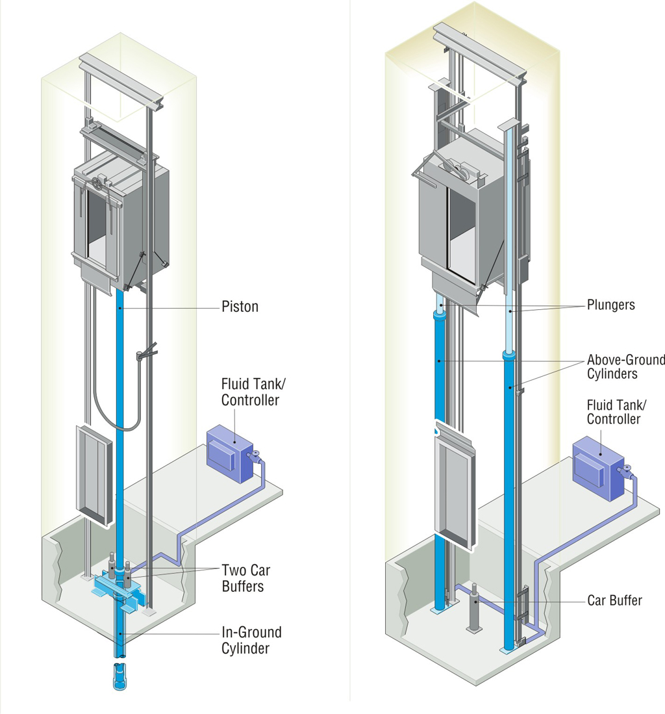

Slide 5

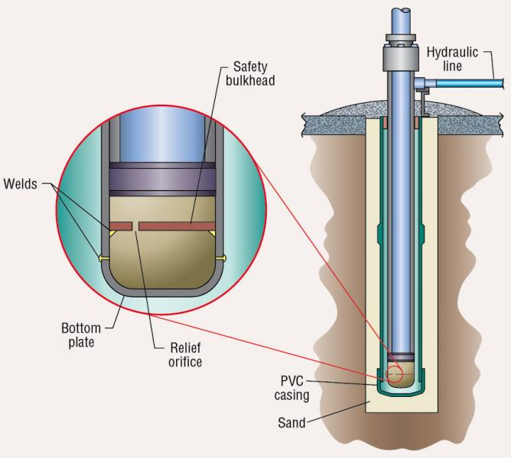
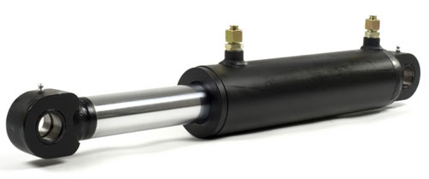
Hydraulic cylinder/Piston
The cylinder is connected to a fluid-pumping system, most of the its oil, but it could work with other incompressible fluids.
It has three parts, A tank (fluid reservoir), a pump and, a valve between the cylinder and the reservoir.

Slide 6
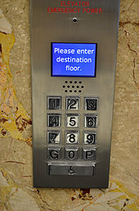

Valve/Destination control panel
It's basically a control panel in the elevator car that controls the amount of pressure put into the piston and brings it to a certain floor.

Slide 7
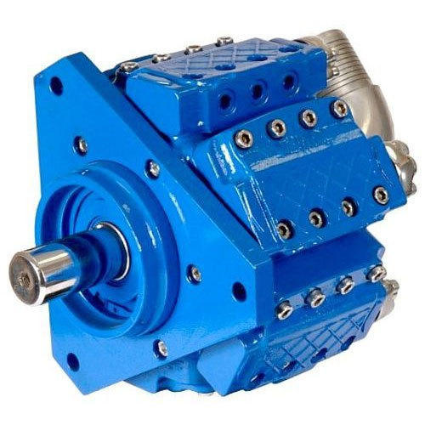
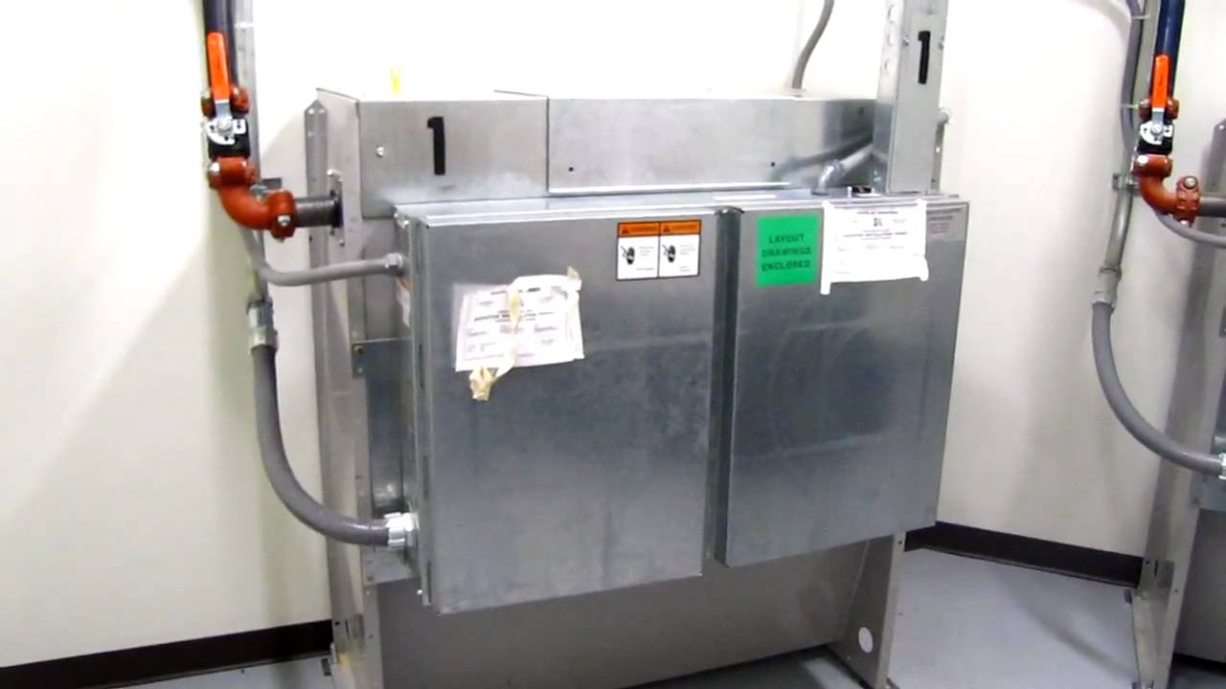
Pump
The pump maintains the pressure in the piston

Slide 8
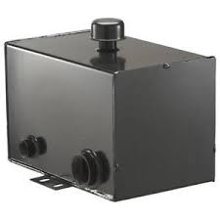
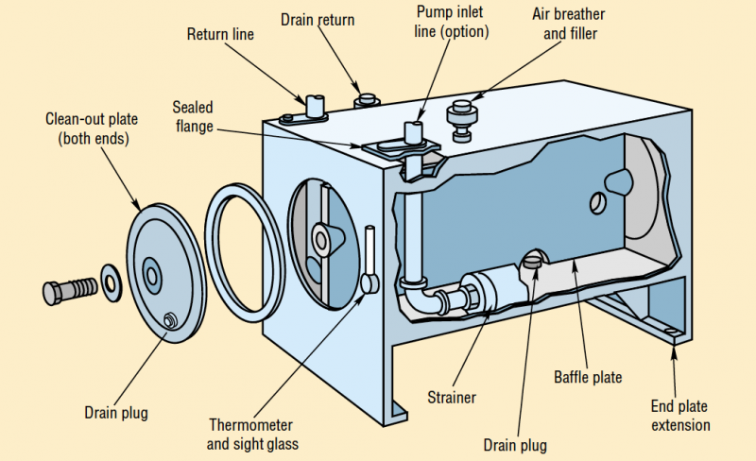
Fluid Reservoir
Holds the fluid that is used to make the piston move up and down

Slide 9

THE END

